Slide 1

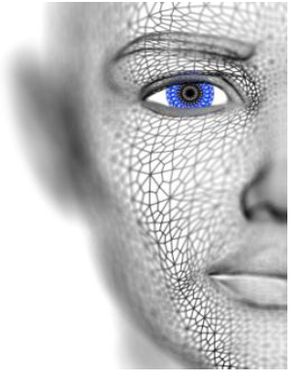
University of Missouri-Columbia - College of Engineering – Electrical Engineering and Computer Science Dept.
Localized Deep Learning Structure for The Large-Scale Biometric Data Recognition
PhD Candidate EECS
Adil Al-Azzawi
Adil Al-Azzawi

Slide 2
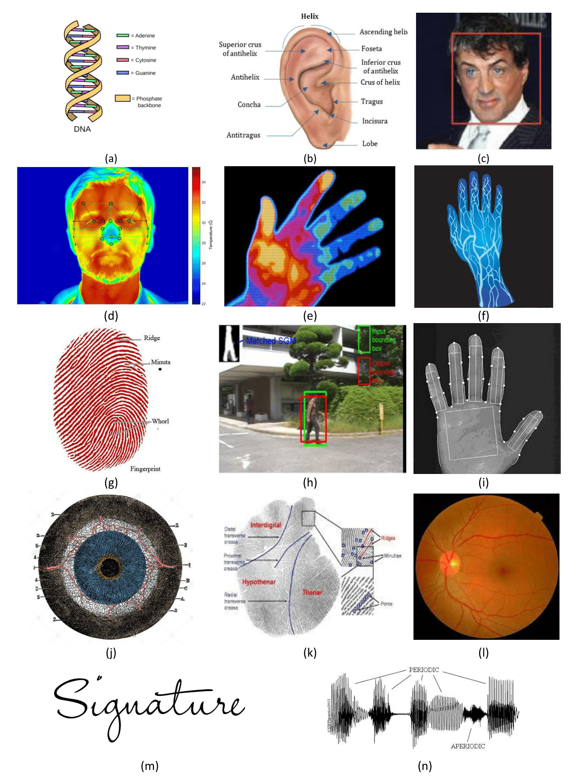
Large-Scale Biometric Data Recognition
Biometric Data Technologies
(a) DNA prediction, and Identification
(b) Ear recognition.
(c) Face recognition, Identification,
and verification
(d) Facial thermogram recognition
(e) Hand thermogram recognition
(f) Hand vein recognition
(g) Fingerprint recognition,
authentication
(h) Gait recognition
(i) Hand geometry recognition
(j) Iris recognition, and prediction
(k) Palmprint recognition
(l) Retina recognition
(m) Signature recognition, and
verification
(n) Voice recognition, and Identification
Adil Al-Azzawi

Slide 3







Dataset Collection
No. | Aim | # Persons | Total # images
1 | Labeled Faces In the Wild | 5,749 | 13,233
2 | WDRef | 2995 | 99,773
3 | Celeb Faces | 10177 | 202,599
5 | Facebook | 4030 | 4.4M
6 | Google | 8M | 200M
Adil Al-Azzawi

Slide 4
Previous Work
Biometric Large-scale Face Datasets
Our Approaches For Deep Learning Face Recognition
Approach #1: Localized Deep Face Recognition
Approach #2: Latent CNN Structure for Deep Face
Approach #3 Deep Learning Approach for Face verification using a Latent CNN Face Image Retrieval based Model
Adil Al-Azzawi

Slide 5
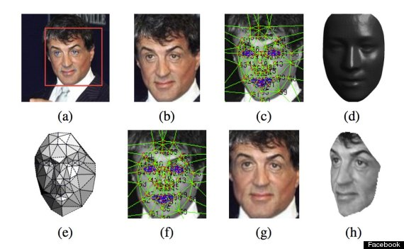
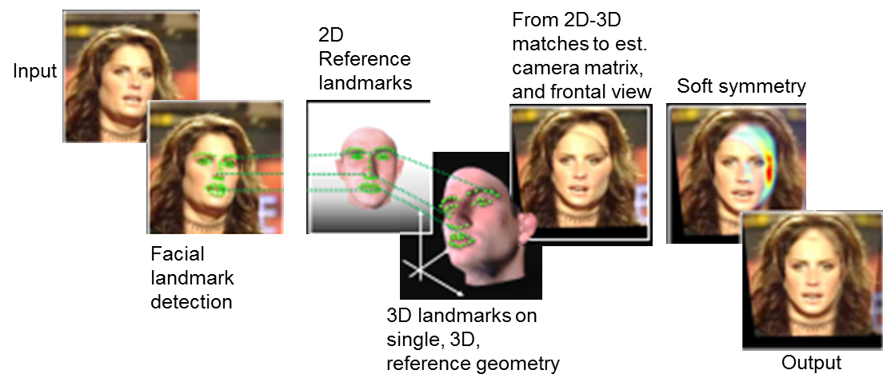
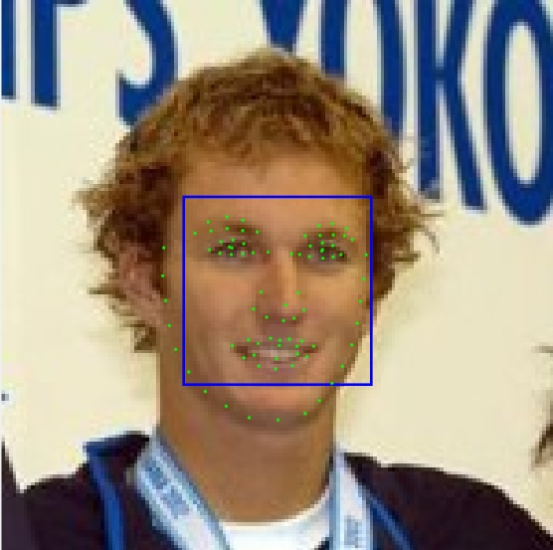
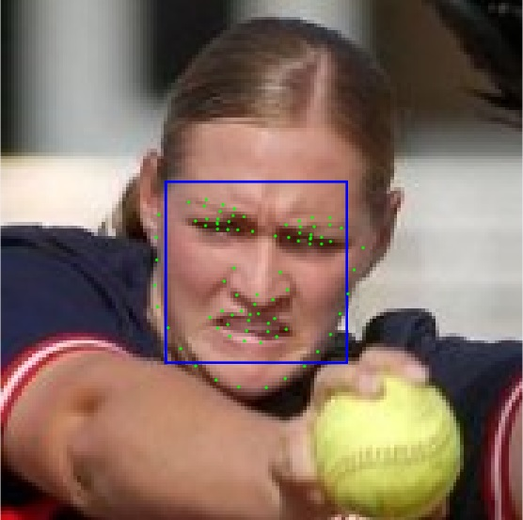
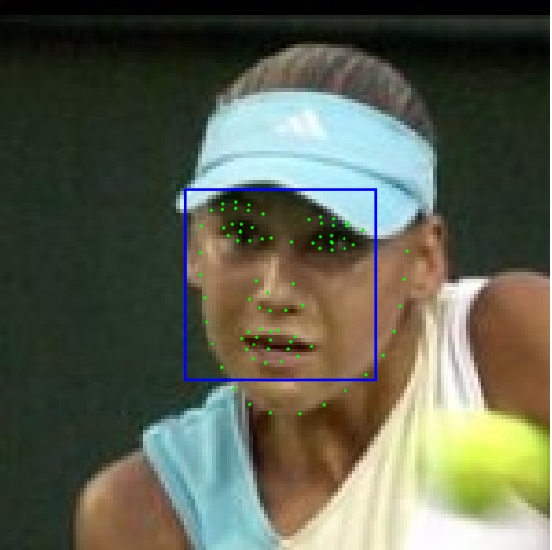
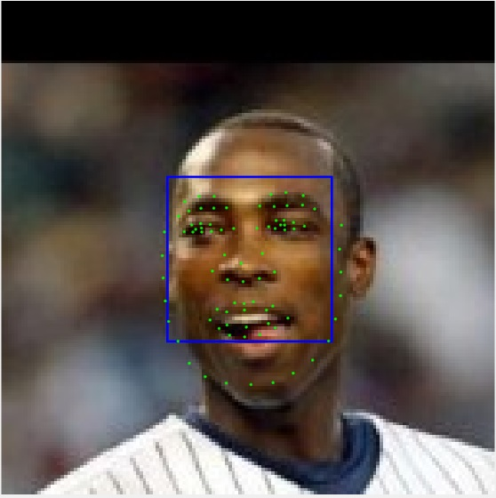
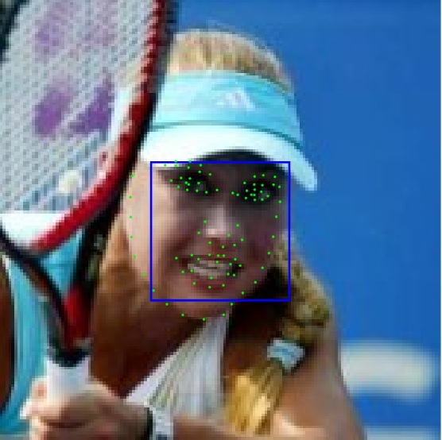
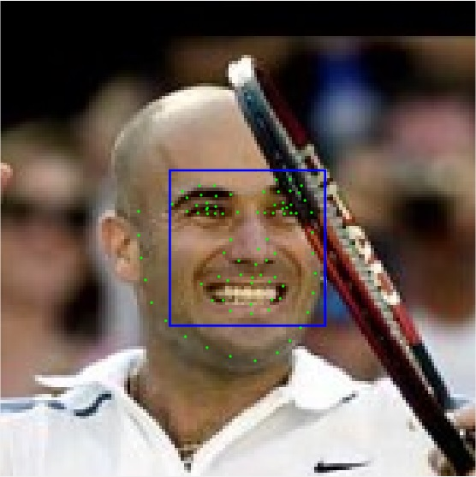
Face Frontalization
Effective Face Frontalization in Unconstrained Images
Synthesize front-facing views of faces in single unconstrained photos
Optimal facial feature points selection for (soft symmetry)
Landmark Detection on LFW (48 points)
Select the ROI in each face
Effective Face Frontalization in Unconstrained Images
Adil Al-Azzawi

Slide 6
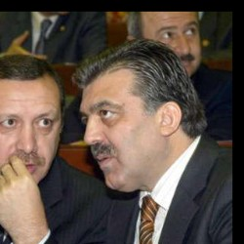
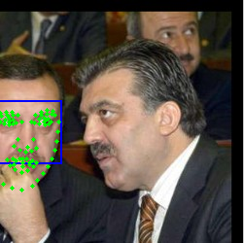

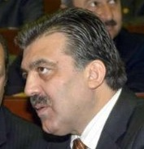

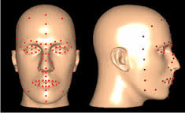
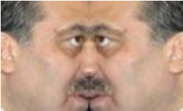
Face Frontalization
Our modification
Build a dictionary model for facial points.
Use a conditional face symmetry
Localized Face selection using Faster R-CNN
Input Face
Landmark Detection
Detected
Right Detection
using Faster R-CNN
False Landmark Detection
Input Face
Landmark Dictionary and Fast R-CNN
Right Detection
using Faster R-CNN
Frontalization
Using face symmetry
Adil Al-Azzawi

Slide 7
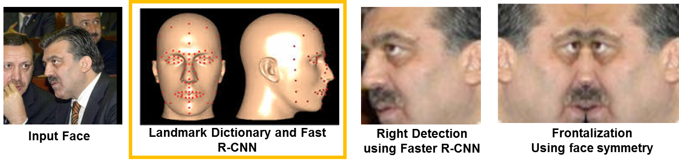
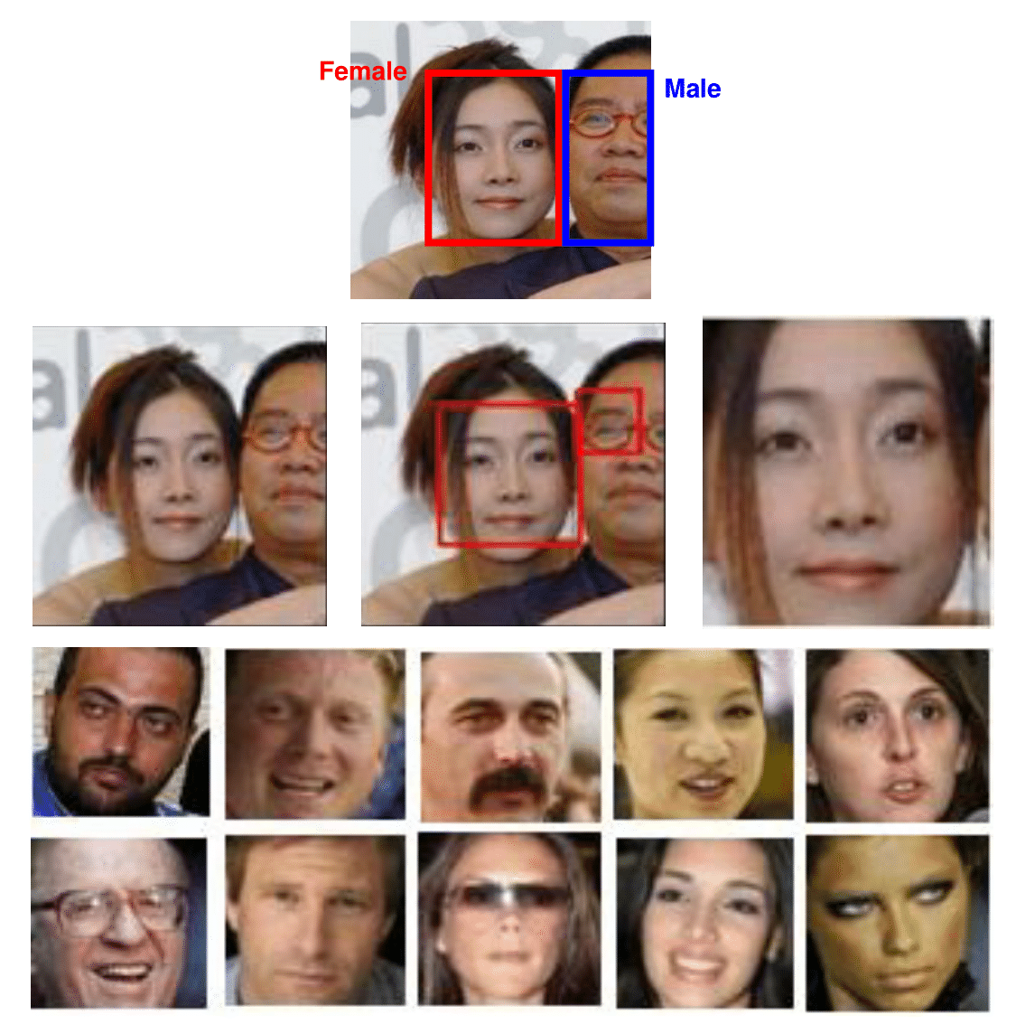
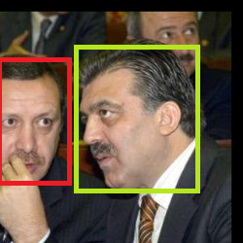
Our Face Frontalization
Our face frontalization modification
Wrong Person
Right Person
Adil Al-Azzawi

Slide 8
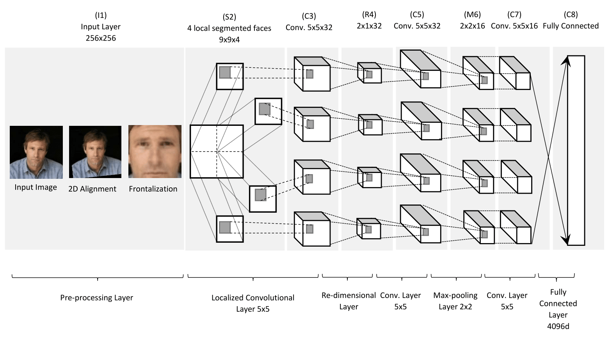
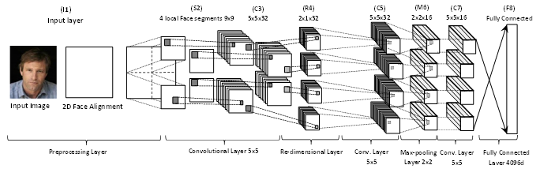
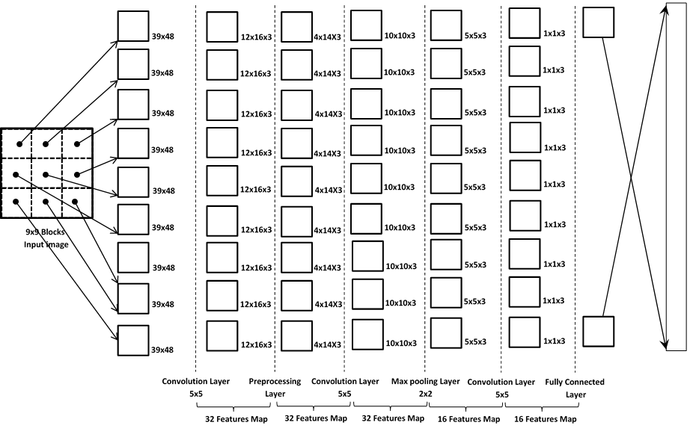
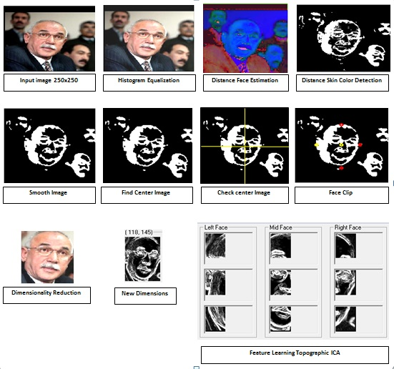
Approach #1: Localized Deep Face Recognition
Localized Deep Learning Face Recognition
Setup | Training | Testing | Accuracy
View 1 | 4038 images | 1711 images | 96.33%
Setup | Data | Training | Accuracy
View 2 | 10 sets | 10 fold | 96.13%
Adil Al-Azzawi, Tony X. Han, Localized Learning Face Recognition, was submitted to CVPR 2014
Adil Al-Azzawi

Slide 9
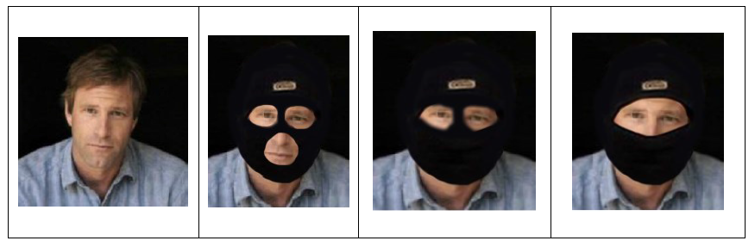
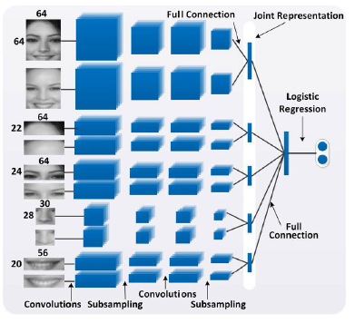
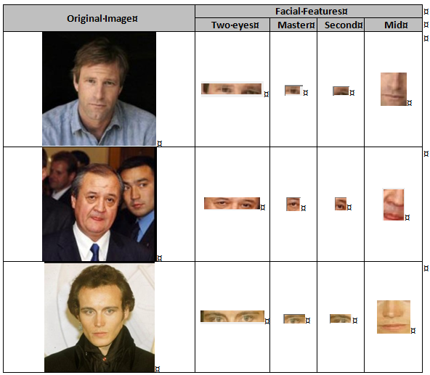
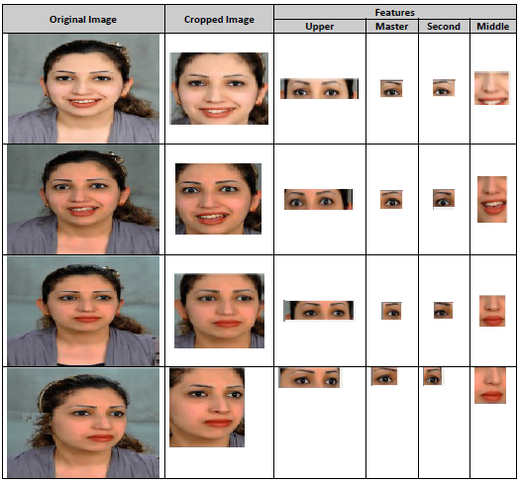
Localized Pipeline Deep Face
Localized Pipeline Learning Face Recognition
Facial Component Deep Network for Face recognition
Yi Sun1 Xiaogang Wang Xiaoou Tang‘’Deep Learning Face Representation from Predicting 10,000 Classes’’
Zhenyao Zhu, Ping Luo, Xiaogang Wang and Xiaoou Tang,” Recover Canonical-View Faces in the Wild with Deep Neural Networks”, Department of Information Enginering， The Chines University of Hong Kong, 2Department ofElectronic Engineering, The Chinese University of Hong Kong 3Shenzhen Institutes of Advanced Technology, Chinese Academy of Sciences.
Adil Al-Azzawi

Slide 10
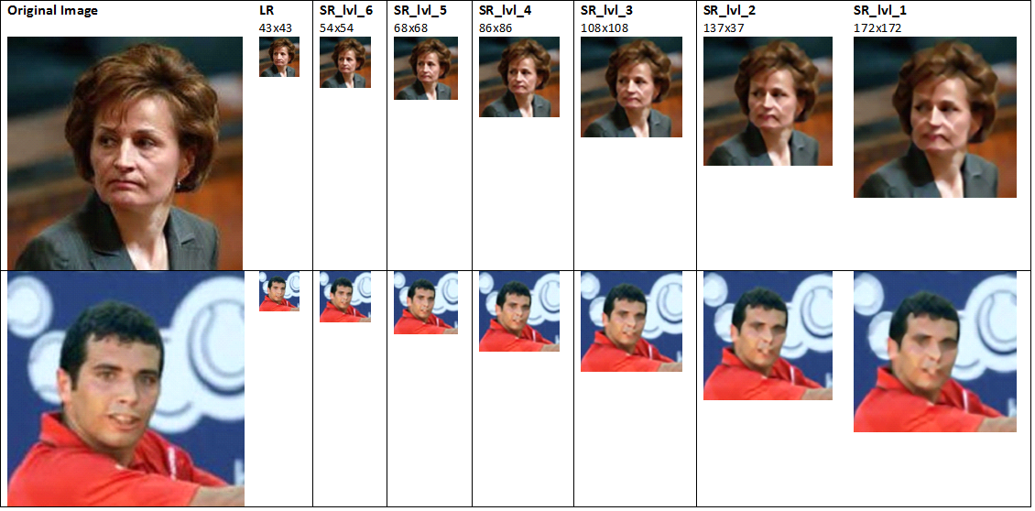
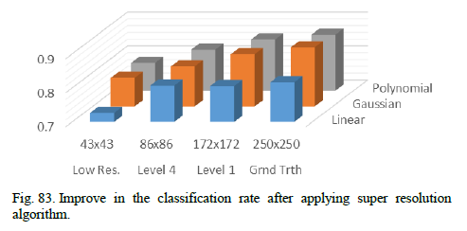
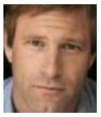
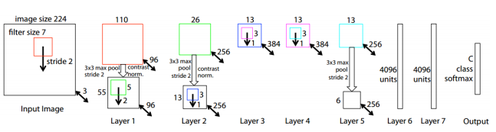
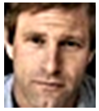
Super Resolution-Deep Face Recognition
Image Super Resolution Learning Face Recognition
Original dimension reduction
Speed-Up Deep Learning approach for face Recognition
108x126 original image
40x40 super pixel image
Adil Al-Azzawi, Moein Enayati Improving Gender Identification Accuracy from Facial Images by Means of Signal Image Super Resolution
Adil Al-Azzawi

Slide 11
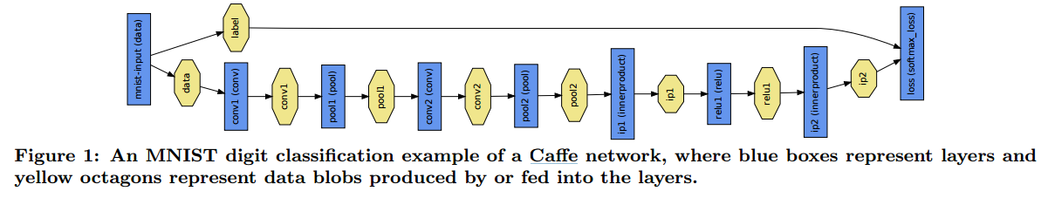
Approach #2: Latent CNN Structure for Deep Face
A latent CNN Structure for Deep Face Recognition
Latent Deep Face Recognition based on Convolution Neural Network to learn a robust feature for face verification task.
The popular deep learning framework caffe is used for training on faces datasets.
Preprocessing Model:
All face images are processed with the frontalization approach
Training Model:
The model A and B : using CASIA-WebFace dataset to train the models.
The model C: using is MS-Celeb-1M dataset to train the model.
Evaluation Model:
The model is evaluated on LFW which is a popular data set for face verification task.
The model is also evaluated on MegaFace
Wu, Xiang, et al. "A Light CNN for Deep Face Representation with Noisy Labels." arXiv preprint arXiv:1511.02683 (2015).
Adil Al-Azzawi

Slide 12
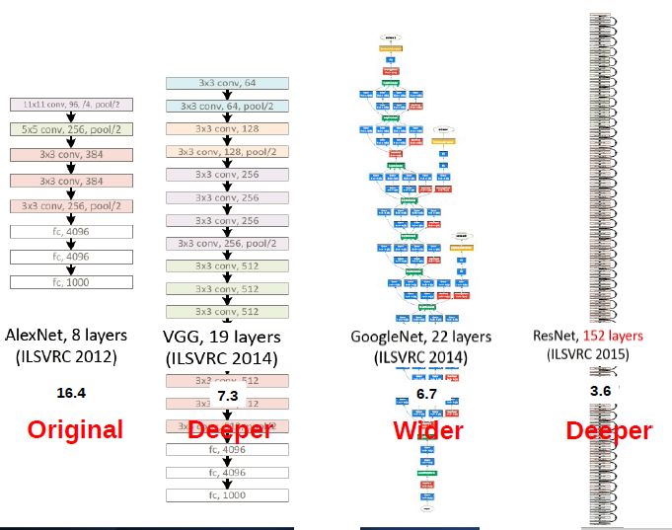
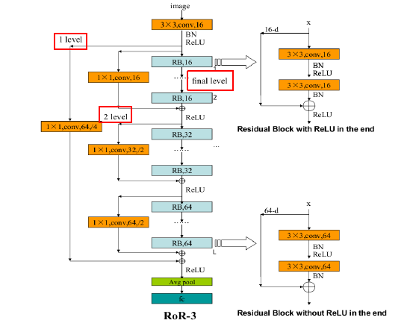

CNN Structures
Residual Networks of Residual Networks: RoR
Wider
Ke Zhang, Miao Sun, Tony X. Han, Xingfang Yuan, Liru Guo, Tao Liu, Residual Networks of Residual Networks: Multilevel Residual Networks, arXiv:1608.0
Adil Al-Azzawi

Slide 13
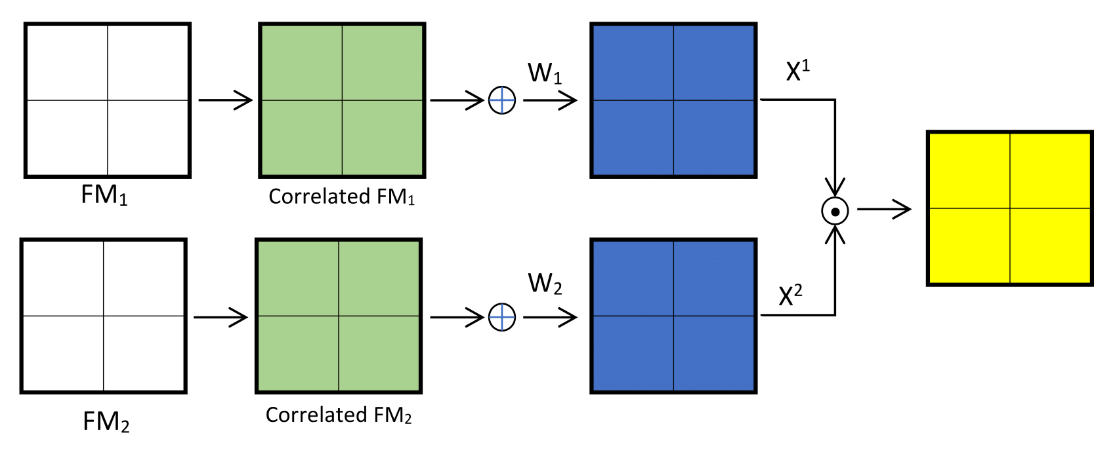
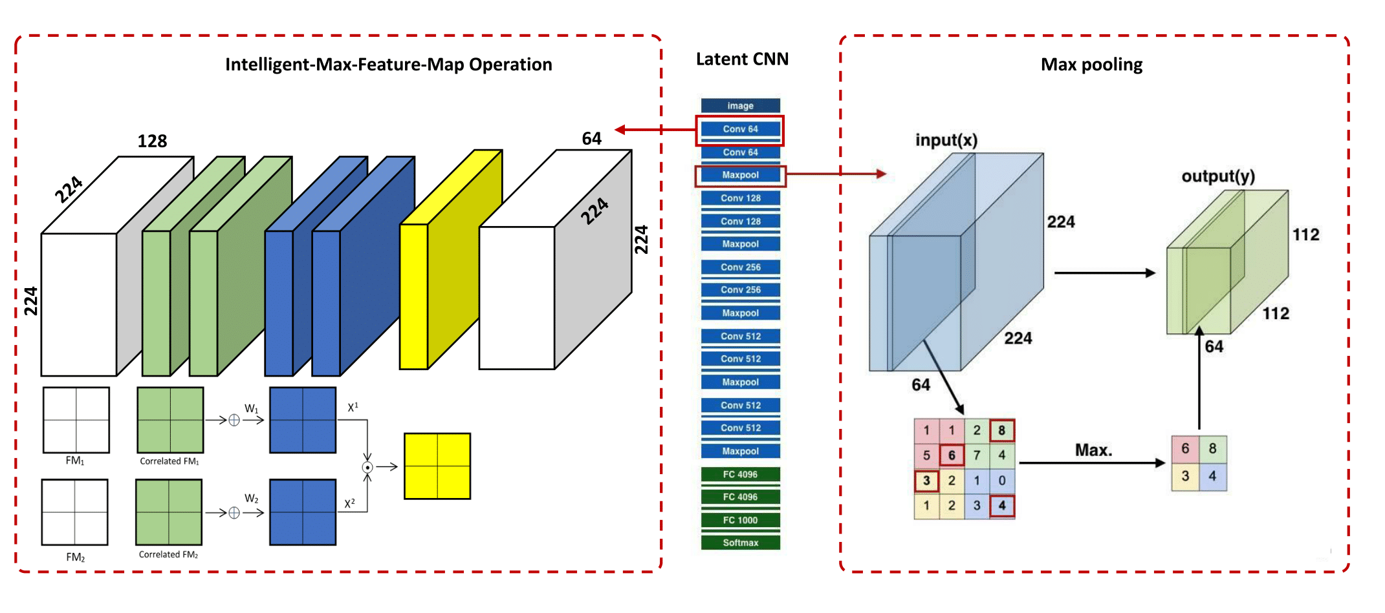
Improve CNN-wider Structure
A latent CNN Structure for Deep Face Recognition
Verity types of noise in large-scale dataset.
The inhabitation of neuron corresponding (vertical/horizontal) lines.
The inhabitation of free neuron’s parameters.
We propose the Intelligent-Feature-Map-Selection (IMFM)
Xiang Wu, Ran He, Zhenan Sun, Tieniu Tan, ”A Light CNN for Deep Face Representation with Noisy Labels”
Adil Al-Azzawi
Notes:
Since large-scale dataset often contains various types of noise, we expect that noisy signals and informative signals can be separated.
2. When there is a horizontal edge or line in an image, the neuron corresponding to horizontal information is excited whereas the neuron corresponding to vertical
information is inhibited.
3. The inhabitation of one neuron is parameter free so that it does not depend on training data very much.
Given an input convolution layer $x^{n}∈R^{H×W}$, where $n = \{1, …, 2N\}$, $W$ and $H$ denote the spatial width and height of the feature map.
The MFM 2/1 operation which combines two feature maps and outputs element-wise maximum one as shown in Fig. (c) can be written as:

Slide 14
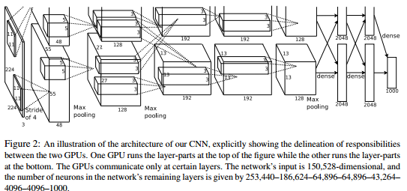
Approach #3: Deep Learning for Face verification
Deep Learning Approach for Face verification using latent CNN Face Image Retrieval based Model
The popular deep learning framework AlexNet is used for training
The popular datasets CASIA-WebFace and MS-Celeb-1M.
The CNN architecture A
Consist 11 layers, the first eight layers are linear operator is a bank of linear filters (linear convolution).
The last three Layers are instead called Fully Connected (FC).
The first two FC layers output are 4,096 dimensional and the last FC layer.
The CNN architecture B and C
Networks B and C are similar to A but include 2 and 5 additional convolution layers respectively
Parkhi, Omkar M., Andrea Vedaldi, and Andrew Zisserman. "Deep Face Recognition." BMVC. Vol. 1. No. 3. 2015.
Adil Al-Azzawi
Notes:
FC: they are the same as a convolutional layer, but the size of the filters matches the size of the nput data, such that each filter “senses” data from the entire image

Slide 15
Previous & Current Work
Biometric Large-scale Fingerprint and Bioinformatics Datasets
Approach #1: A Robust Spatially Invariant Model for Latent Fingerprint Authentication
Approach #2: Deep Learning Approach for Secondary Structure Protein Prediction based on First Level Features Extraction using a Latent CNN Structure
Adil Al-Azzawi

Slide 16
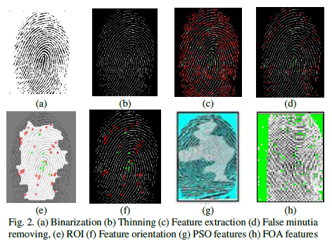
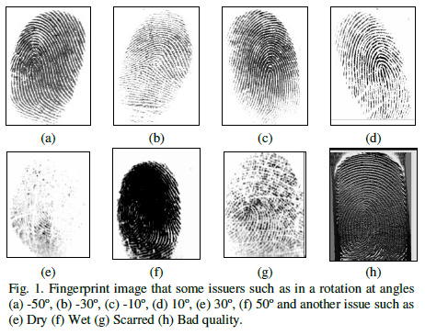

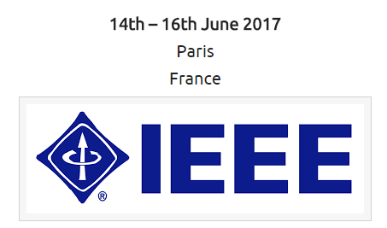
Previous & Current Work
Large-scale Biometric Fingerprint Datasets
Approach #1: A Robust Spatially Invariant Model for Latent Fingerprint Authentication
Adil Al-Azzawi, Tony X. Han, “A Robust Spatially Invariant Model for Latent ingerprint Authentication Approach”, IEEE, DeSE, Developments in eSystems Engineering 2017
Adil Al-Azzawi

Slide 17
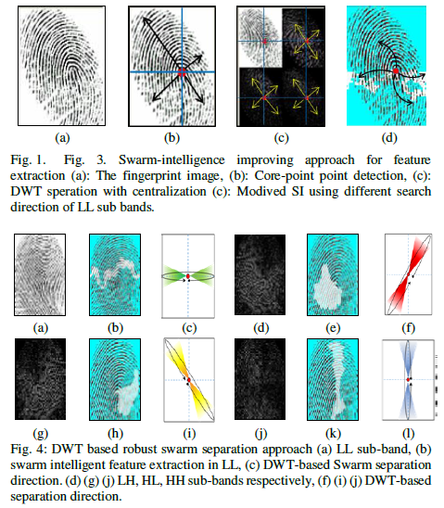
Previous Work
Large-scale Biometric Fingerprint Datasets
Approach #1: A Robust Spatially Invariant Model for Latent Fingerprint Authentication
LATENT SWARM-INTELLIGENCE PROPOSED SYSTEM
Robustness Swarm-Intelligence Feature Extraction (PSO and FOA)
Centralization (Swarm-Intelligence Initialization)
DWT-based Robust Fingerprint Localization Approach
Robust Swarm Features Connection/Selection Approach
Invariant Moments Matching
Adil Al-Azzawi, Tony X. Han, “A Robust Spatially Invariant Model for Latent ingerprint Authentication Approach”, IEEE, DeSE, Developments in eSystems Engineering 2017
Adil Al-Azzawi

Slide 18
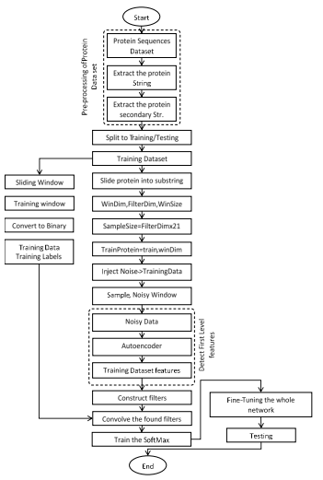
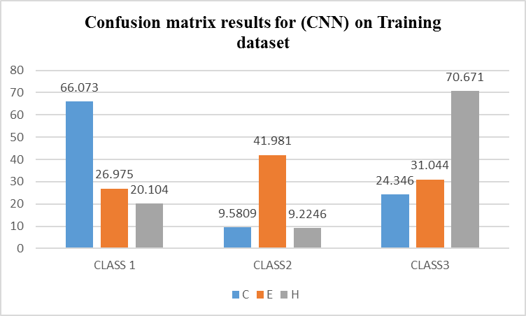
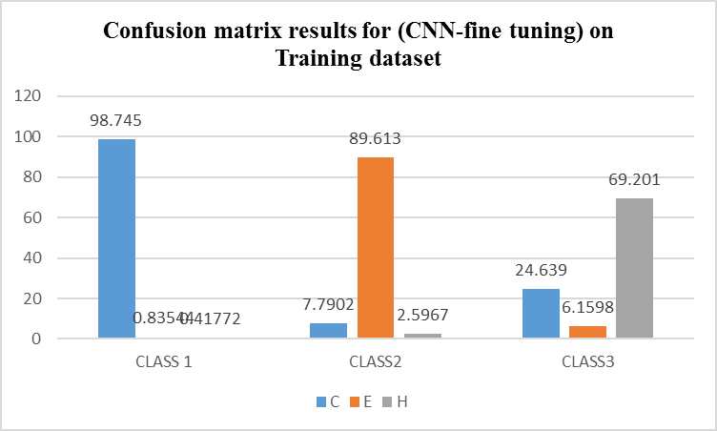
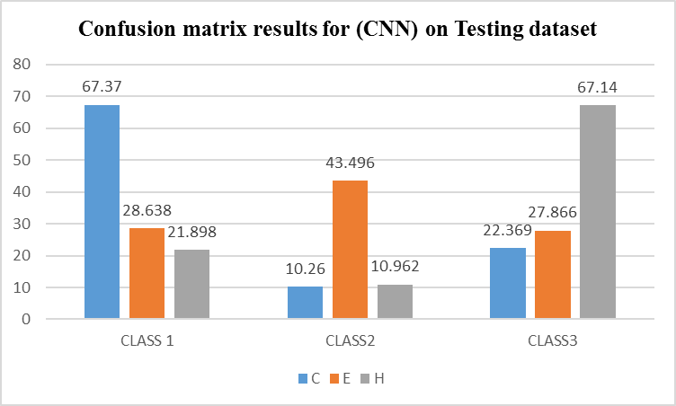
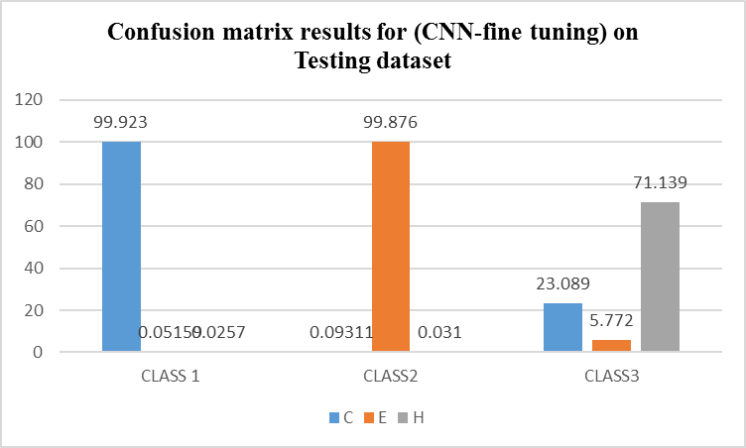

Previous Work
Large-scale Biometric Bioinformatics Datasets
Approach: Deep Learning Approach for Secondary Structure Protein Prediction based on First Level Features Extraction using a Latent CNN Structure
Adil Al-Azzawi

Slide 19
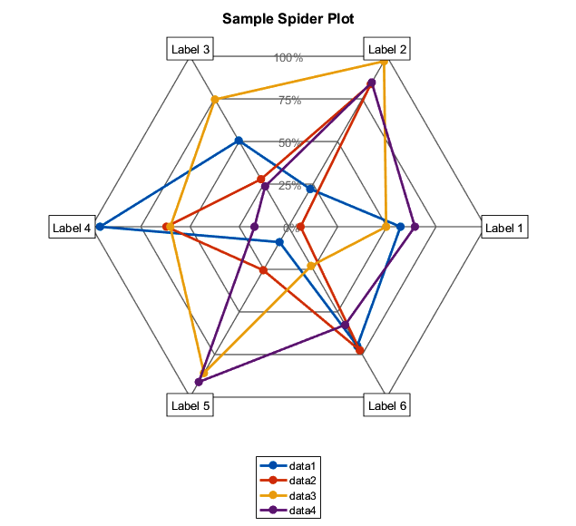
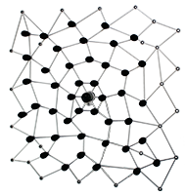
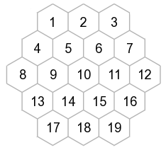
Current and Future Work
Approach #1: Deep Learning Approach for Secondary Structure Protein Function Prediction using
Approach #2: Spider-Web based Model (Heuristic Random Space Searching Approach and Data structure) for Biometric Fingerprint Identification
Our STRUCTURE (Latent CNN and Deep-Sparse Autoencoder)
Adil Al-Azzawi

